Slide 1
Computer-aided Maintenance “Moj vzdrževalec” Database
Notes:
Computer-aided maintenance

Slide 2
Lesson Outline
Database review
Solar tracking system
Tasks
Review of key words

Slide 3
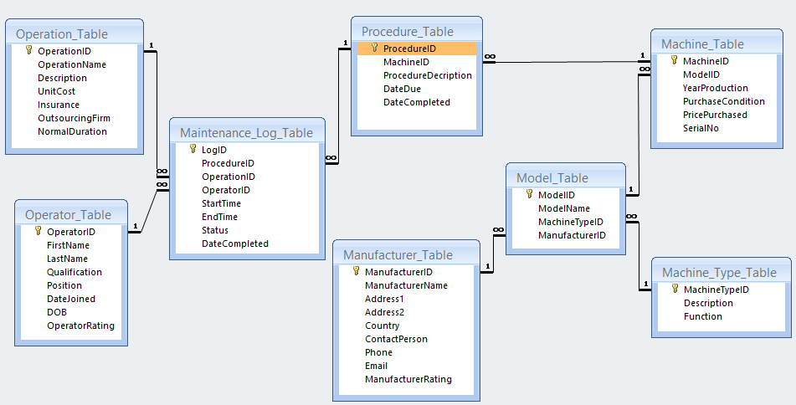
Database Structure
Notes:
Heart of our database

Slide 4
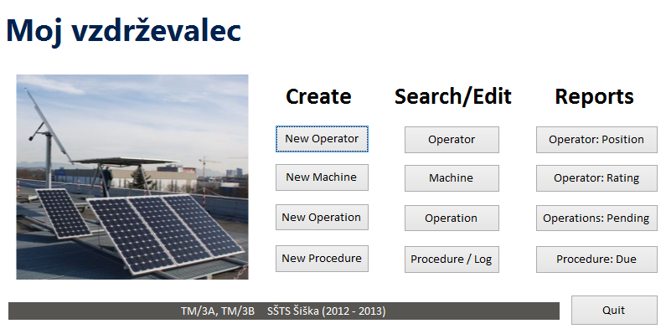
Main Menu
Notes:
Helena: Main menu in general, looking more professional
Amresh: Which entities can we create?

Slide 5
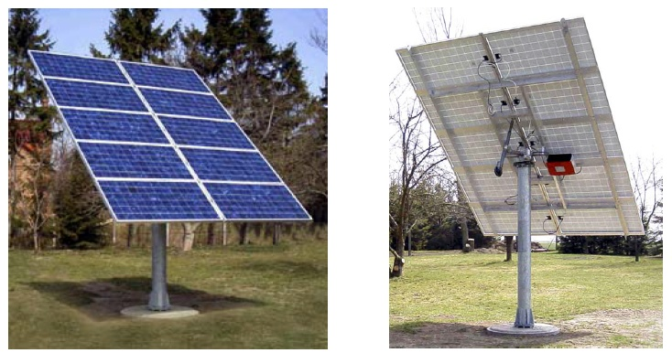
Solar Tracking System
New Procedure (with 5 operations)
Notes:
Amresh: intro of today’s focus (solar tracker)
Helena: focus on Mechatronics

Slide 6
Procedure and Operations
Procedure: Sensor replacement
Operations:
Turn off power supply
Replace sensors
Turn on power supply
Parameter test
Launch operational procedure
Notes:
Amresh: ask a student to read and translate for Helena
Helena: discusses Mechatronics questions about it

Slide 7
Task 1: Add Machine
Use the main menu to add a new machine in the system.
The required data is in your handout.

Slide 8
Task 2: New Procedure
Use the main menu to start a new procedure in the system.
The required data is in your handout.

Slide 9
Task 3: Complete Procedure
Use the main menu to search and complete the previous procedure.
The required data is in your handouts

Slide 10
Task 4: POSITION Query
Create a query that requests the user to enter POSITION for an operator, and then displays all the operators who work in this position.

Slide 11
Task 5: Calculate Duration of Operation
Create a query that displays the main details of the table “Maintenance_Log” and also the duration (in minutes) of each operation.

Slide 12
Task 5: Calculate Duration of Operation
Duration: DateDiff("n",
[StartTime],[EndTime])

Slide 13
Review of key words
My key words from this lesson are:

